Slide 1

Data-Driven Insights for Digital Marketing Campaigns
Project 7 By Anandha Lakshmi K

Slide 2
OVERVIEW
Key Insights:
Engagement Rate: 32.75% (Top: Organic Video)
Total Users: 58K
Conversion Rate: 364.19%
Total Revenue: $3.82K
ROI (Best Channel: Organic Shopping): 24K%
Key Takeaways:
Direct & Organic Search drive highest engagement.
Organic Shopping has highest ROI but low engagement.
Some channels (Email, Cross-Network, Organic Video) show minimal impact.

Slide 3
TRAFFIC & USER ANALYSIS
Total Users: 58K
Total Sessions: 88K
Total Engaged Sessions: 36K
Top Traffic Sources: Direct (49K), Organic Search (8K), Organic Social (1K)

Slide 4
TRAFFIC & USER ANALYSIS
Trends:
Direct traffic is the primary driver
Organic Search shows moderate engagement
Minimal engagement from Organic Social & Video
Recommendations:
Strengthen SEO strategies
Improve social media engagement
Invest in direct & referral traffic strategies

Slide 5
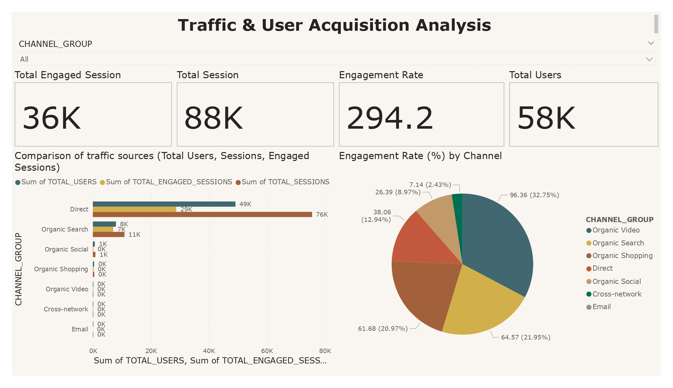

Slide 6
ENGAGEMENT ANALYSIS
Total Engaged Sessions: 36K
Avg. Engagement Time: 57 sec
Highest Engagement Rate:
Organic Video (96.36%)
Organic Search (64.57%)
Direct (61.68%)

Slide 7
ENGAGEMENT TRENDS & RECOMMENDATION
Trends & Patterns:
Organic Video has the highest engagement rate but low traffic.
Organic Search is a strong performer with both traffic & engagement.
Direct traffic contributes significantly to engagement.
Recommendations:
Leverage video content marketing to drive Organic Video traffic.
Optimize landing pages & UX for direct and organic search visitors.
Increase interactive content to improve engagement time.

Slide 8
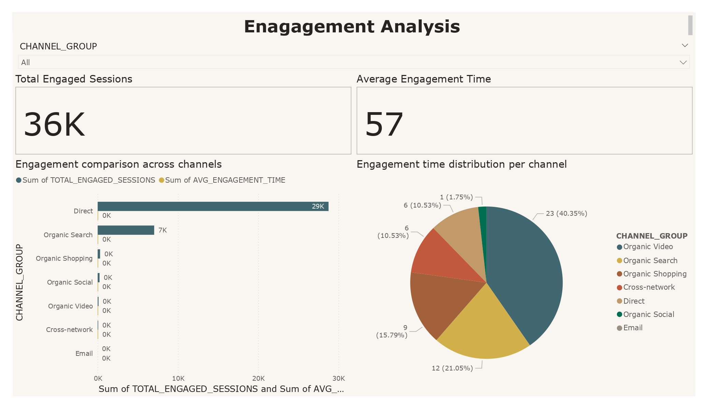

Slide 9
CONVERSION & REVENUE ANALYSIS
Total Conversions: 12K
Conversion Rate: 364.19%
Total Revenue: $3.82K
Top Channels: Direct (6.8K), Organic Search (5.0K)

Slide 10
CONVERSION TRENDS & RECOMMENDATION
Trends:
Direct & Organic Search dominate conversions
Organic Shopping & Video contribute minimal conversions
Recommendations:
Optimize Organic Search content
Improve checkout & conversion funnel
Enhance ad targeting for Organic Shopping & Video

Slide 11
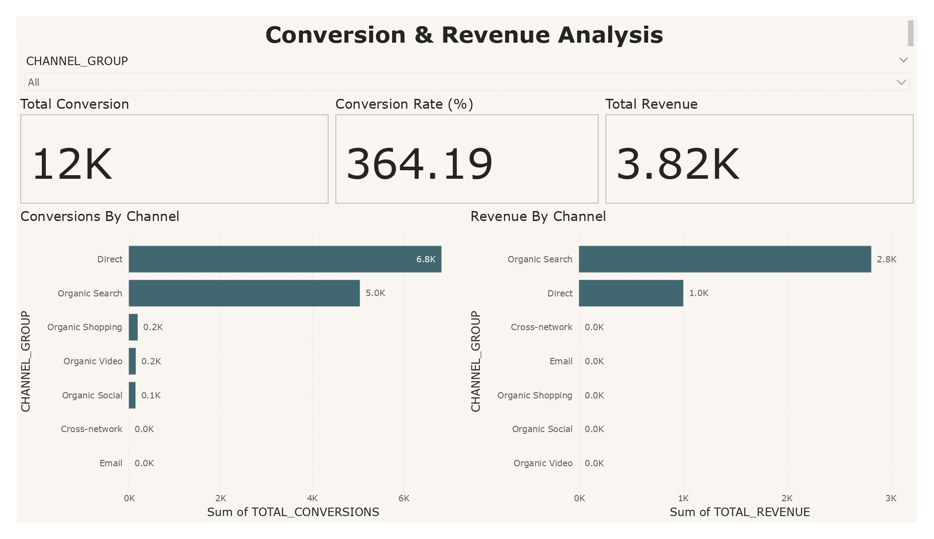

Slide 12
AD PERFORMANCE & ROI ANALYSIS
Total Impressions: 46K
CTR: 50%
Ad Cost: $64
ROI: 24K%
CPC: $0.30 | CPA: $0.36

Slide 13
AD PERFORMANCE & ROI TRENDS & RECOMMENDATIONS
Trends:
Organic Shopping & Referral drive the highest ROI
Paid Search & Social Ads need optimization
Recommendations:
Increase ad spend on high-ROI channels
Refine audience targeting
A/B test ad creatives & CTAs

Slide 14
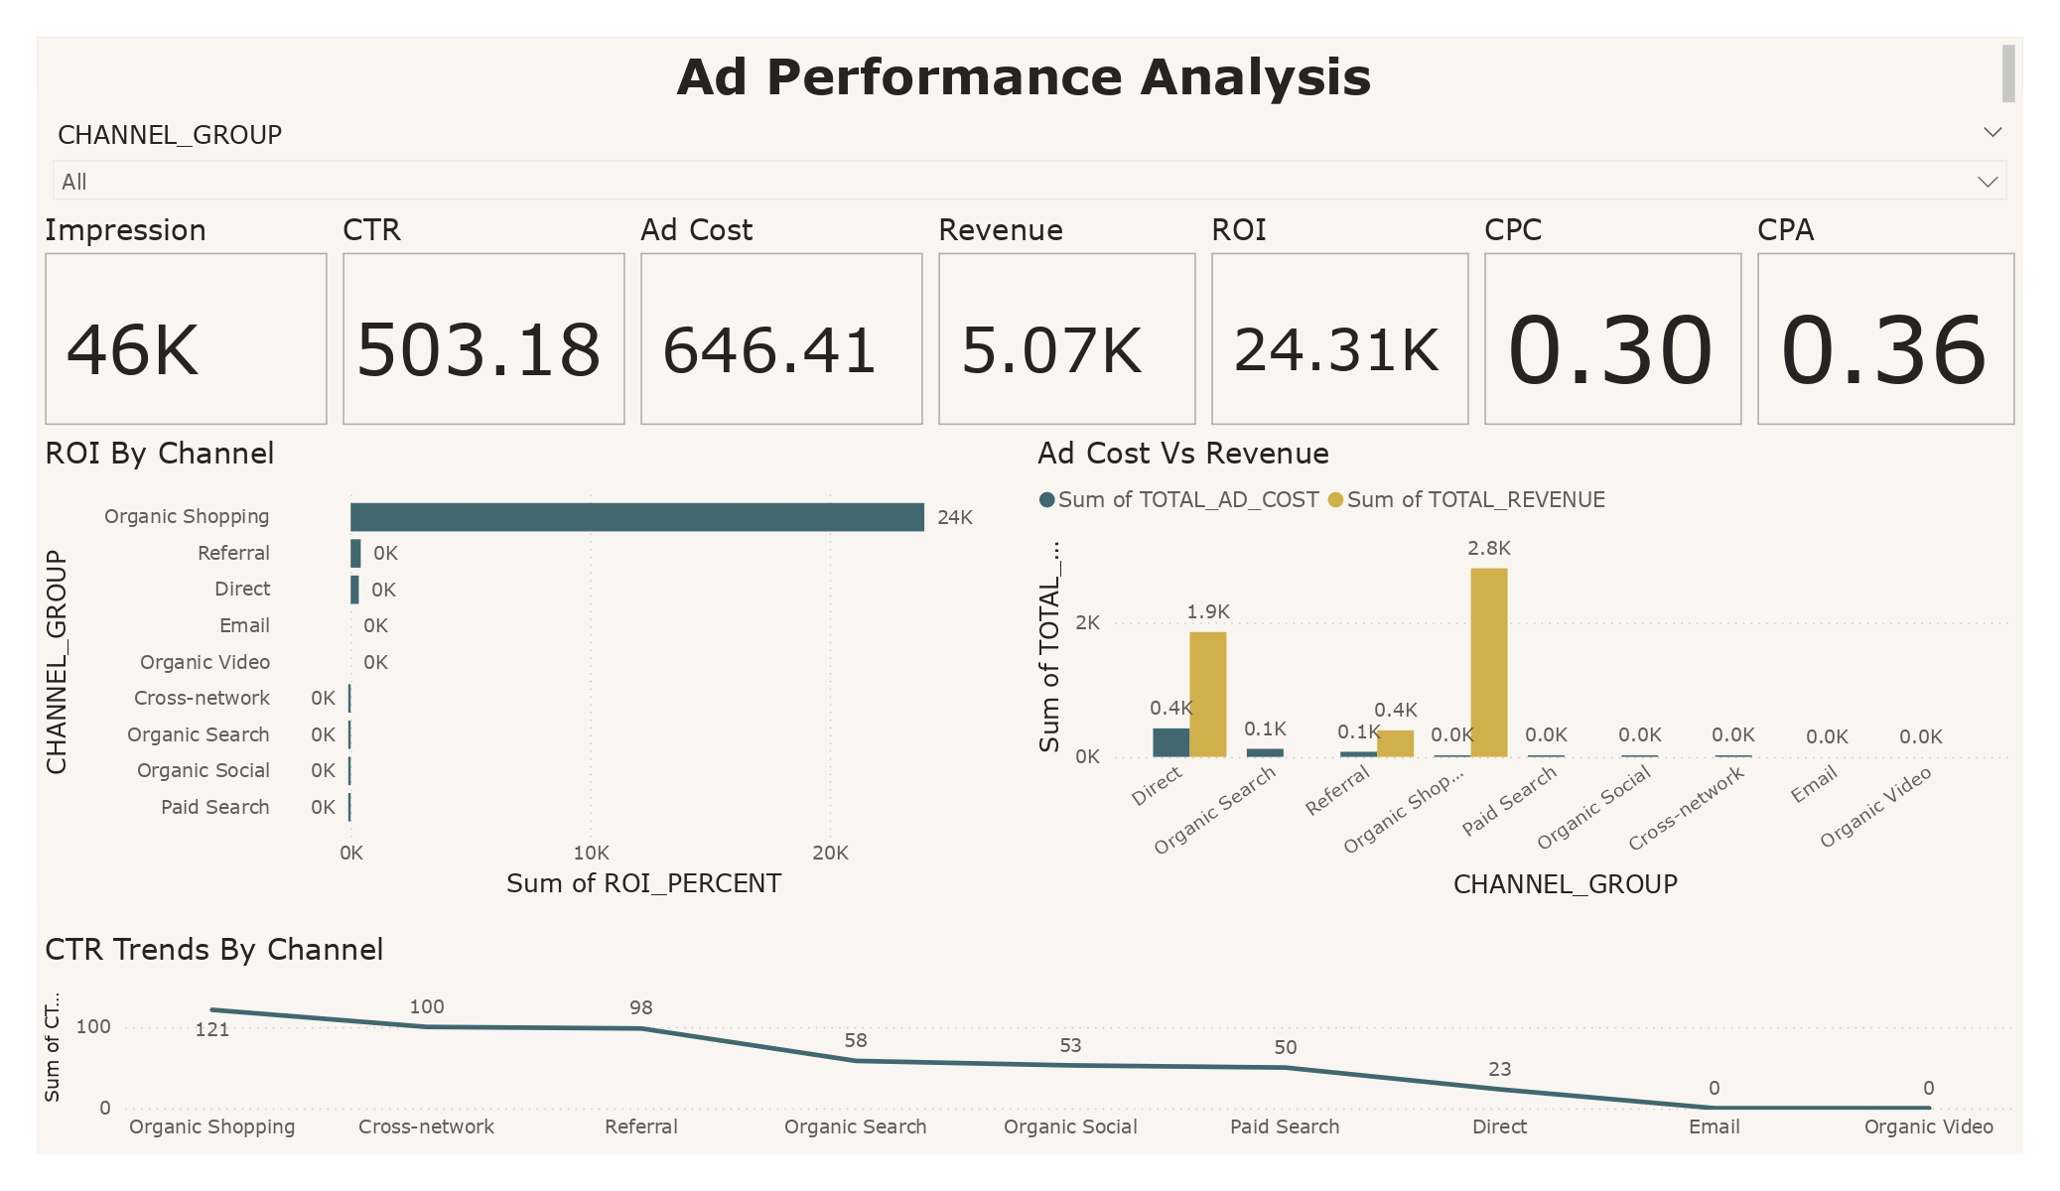

Slide 15
LANDING PAGE PERFORMANCE
Key Insights:
Total Sessions: 67,099
Total Users: 47,549
New Users: 45,029
Avg. Engagement Time: 7 sec
Total Key Events: 2,653
Total Revenue: $1,390
High-performing pages drive the majority of revenue and engagement.(Homepage ("/") is the most visited page (67,099 sessions) Search & Apparel Shop pages are popular)
Some pages have high traffic but low conversions, signaling UX or CTA issues.
Several underperforming pages show zero engagement, possibly due to tracking gaps.

Slide 16
LANDING PAGE PERFORMANCE W
Trends
Top revenue-generating pages align with high engagement times. (Checkout page has higher engagement (9 sec) ,Product detail pages show deep interaction ,Search page drives the highest revenue ($2,811) ,Product pages contribute long-tail revenue )
•Informational pages attract users but need optimization for conversions.
•Pages with the lowest engagement also contribute the least to revenue.
Recommendations:
Improve homepage navigation to convert high traffic.
Enhance checkout flow to reduce drop-offs.
Optimize product pages to increase conversions.

Slide 17
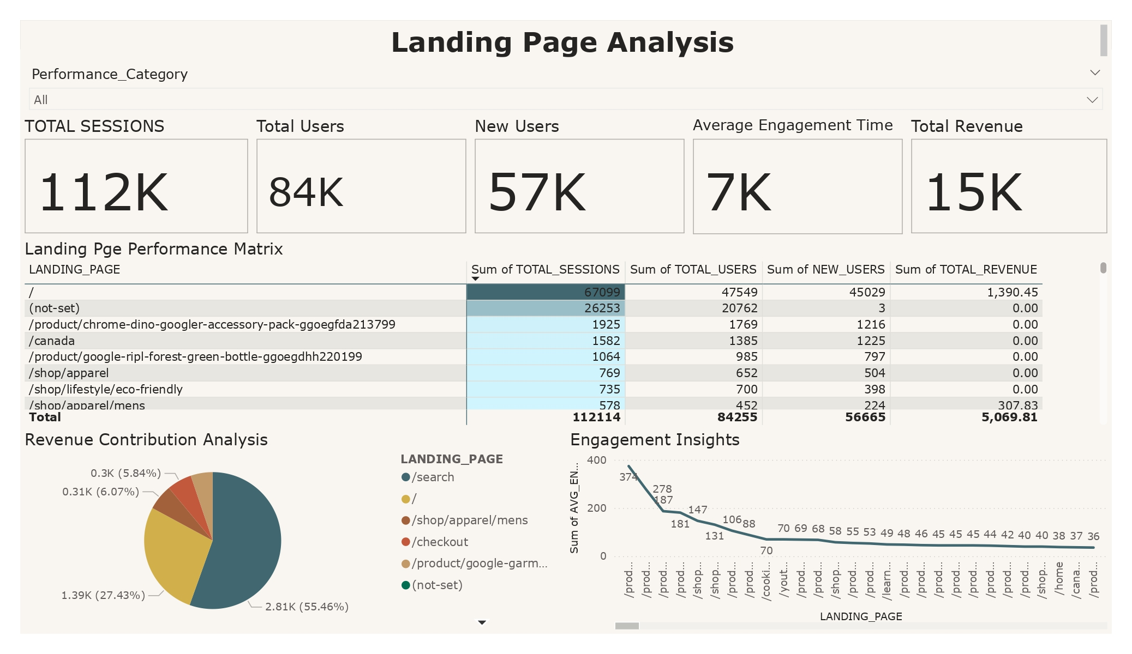

Slide 18
RETENTION & USER LOYALTY ANALYSIS
New Users: 62K
Retained Users: 26K
Avg. Retention Rate: 367%
Best Channels: Direct (18.7K), Organic Search (5.1K)

Slide 19
RETENTION TRENDS & RECOMMENDATION
Trends:
Direct traffic drives long-term retention
Organic Search users are moderately retained
Email & Paid Search show poor retention
Recommendations:
Implement email nurturing campaigns
Create exclusive content & rewards
Improve customer journey mapping

Slide 20
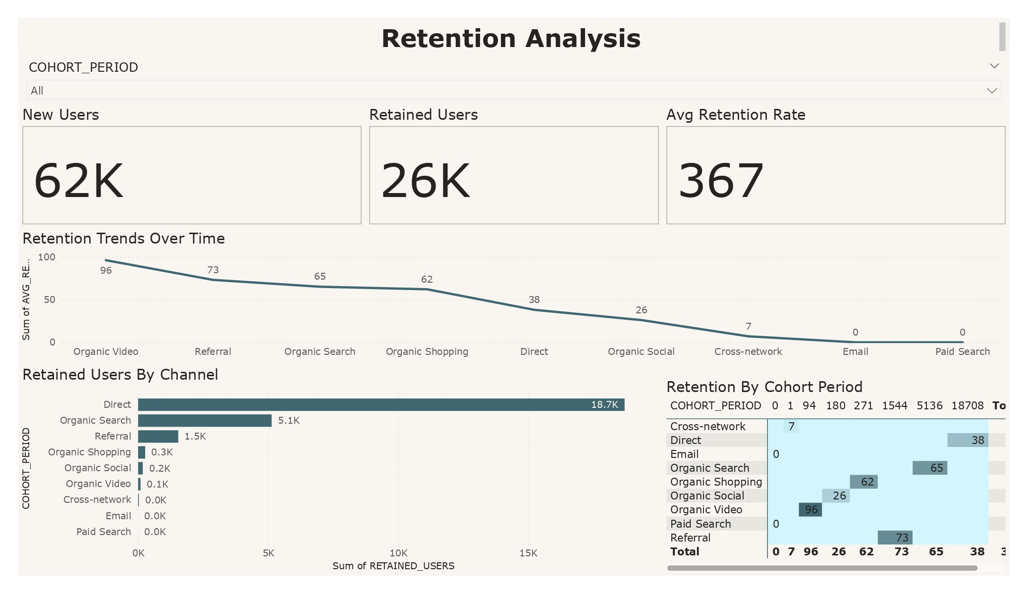

Slide 21
DEMOGRAPHC ANALYSIS
1. Key Insights
Country-wise Analysis
United States has the highest user count (37,862 users), followed by Canada and India.
India and Taiwan have the highest engagement rates (above 55%), indicating highly active users.
Revenue is mostly generated from the US, while other countries contribute little to no revenue.
Age-wise Patterns
Users aged 18-34 show the highest engagement rates (50-55%) and longest average engagement time.
Older users (65+) have a low engagement rate (24%) and a shorter engagement time.
Revenue is highest from the 35-44 age group, despite a lower user count.
Interest-Based Engagement
Technology Enthusiasts and Avid Investors have the highest user counts.
Movie Lovers and TV Viewers contribute significantly to engagement, but not revenue.
Technology users contribute the most revenue ($3,507), while investors contribute very little revenue ($131).
Gender-Based Engagement
Males have the highest engagement rate (50%) and longer session times.
Females generate the highest revenue ($3,085) despite lower engagement.
Unknown gender category dominates user count (35,280 users) but has lower engagement.

Slide 22
DEMOGRAPHIC TRENDS & RECOMMENDATION
Trends and Patterns
High engagement does not always translate to high revenue: Some user groups (e.g., India, Movie Lovers) engage well but do not contribute much revenue.
The 35-44 age group contributes the highest revenue despite a smaller user base.
Males engage more, while females drive higher revenue.
Technology enthusiasts generate the highest revenue, making them a valuable audience segment.
Recommendations
Boost Revenue from High-Engagement Groups - Introduce premium features or paid content for high-engagement groups like India and Taiwan. ✔ Provide personalized offerings for age groups 18-34 to improve monetization.
Target Marketing by Gender & Interests - Focus advertising efforts on females, as they contribute the highest revenue. ✔ Promote Tech and Finance-related services/products to capitalize on high-value interest groups. ✔ Improve engagement for investors with premium financial content or exclusive offers.
Improve Engagement in Low-Performing Segments - Personalize content for older users (65+) to boost engagement. ✔ Provide incentives, such as loyalty programs, for underperforming interest groups.

Slide 23
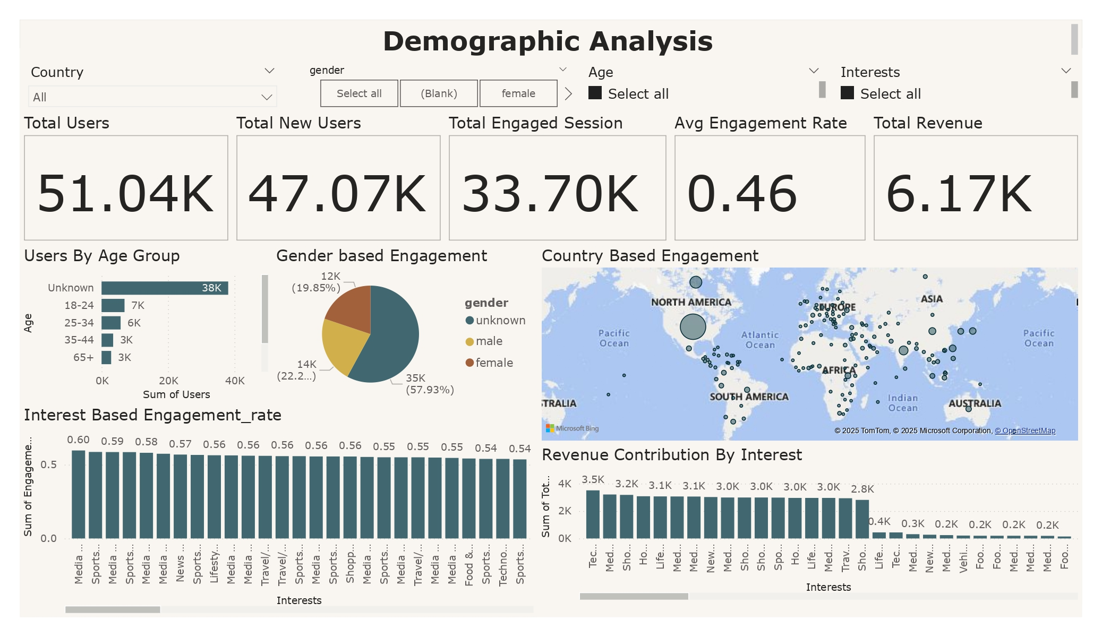

Slide 24
Summary
Key Takeaways
Traffic & Engagement: Direct (49K) and Organic Search (8K) drive the most users. Organic Video has the highest engagement (96.36%) but low traffic.
Conversions & Revenue: Direct & Organic Search lead conversions (12K total). Organic Shopping has the highest ROI (24K%) but minimal engagement.
Ad Performance: CTR – 50%, CPC – $0.30, CPA – $0.36. Paid Search & Social Ads need optimization; Organic Shopping & Referral have the best ROI.
Retention & User Loyalty: Retention Rate – 367%. Direct & Organic Search users are most loyal, while Email & Paid Search show weak retention.
Demographics & Revenue: US drives the highest revenue, while India & Taiwan show high engagement but low conversions. The 35-44 age group contributes the most revenue.

Slide 25
Summary
Recommendations
Boost High-Performing Channels: Strengthen SEO, optimize landing pages, and invest in direct & referral traffic strategies.
Enhance Conversions & Ads: Improve checkout flow, refine ad targeting, and A/B test creatives.
Strengthen Retention & Loyalty: Implement email nurturing, exclusive rewards, and customer journey mapping.
Maximize Revenue Potential: Target high-value user segments (Tech enthusiasts, 35-44 age group, female users) with personalized content and premium offerings.
Focus on high-impact actions to optimize engagement, conversions, and ROI.

